Slide 1


Application site = https://www.etakenya.go.ke/en
Processing time is three (3) working days but in some cases it may take longer.

Slide 2
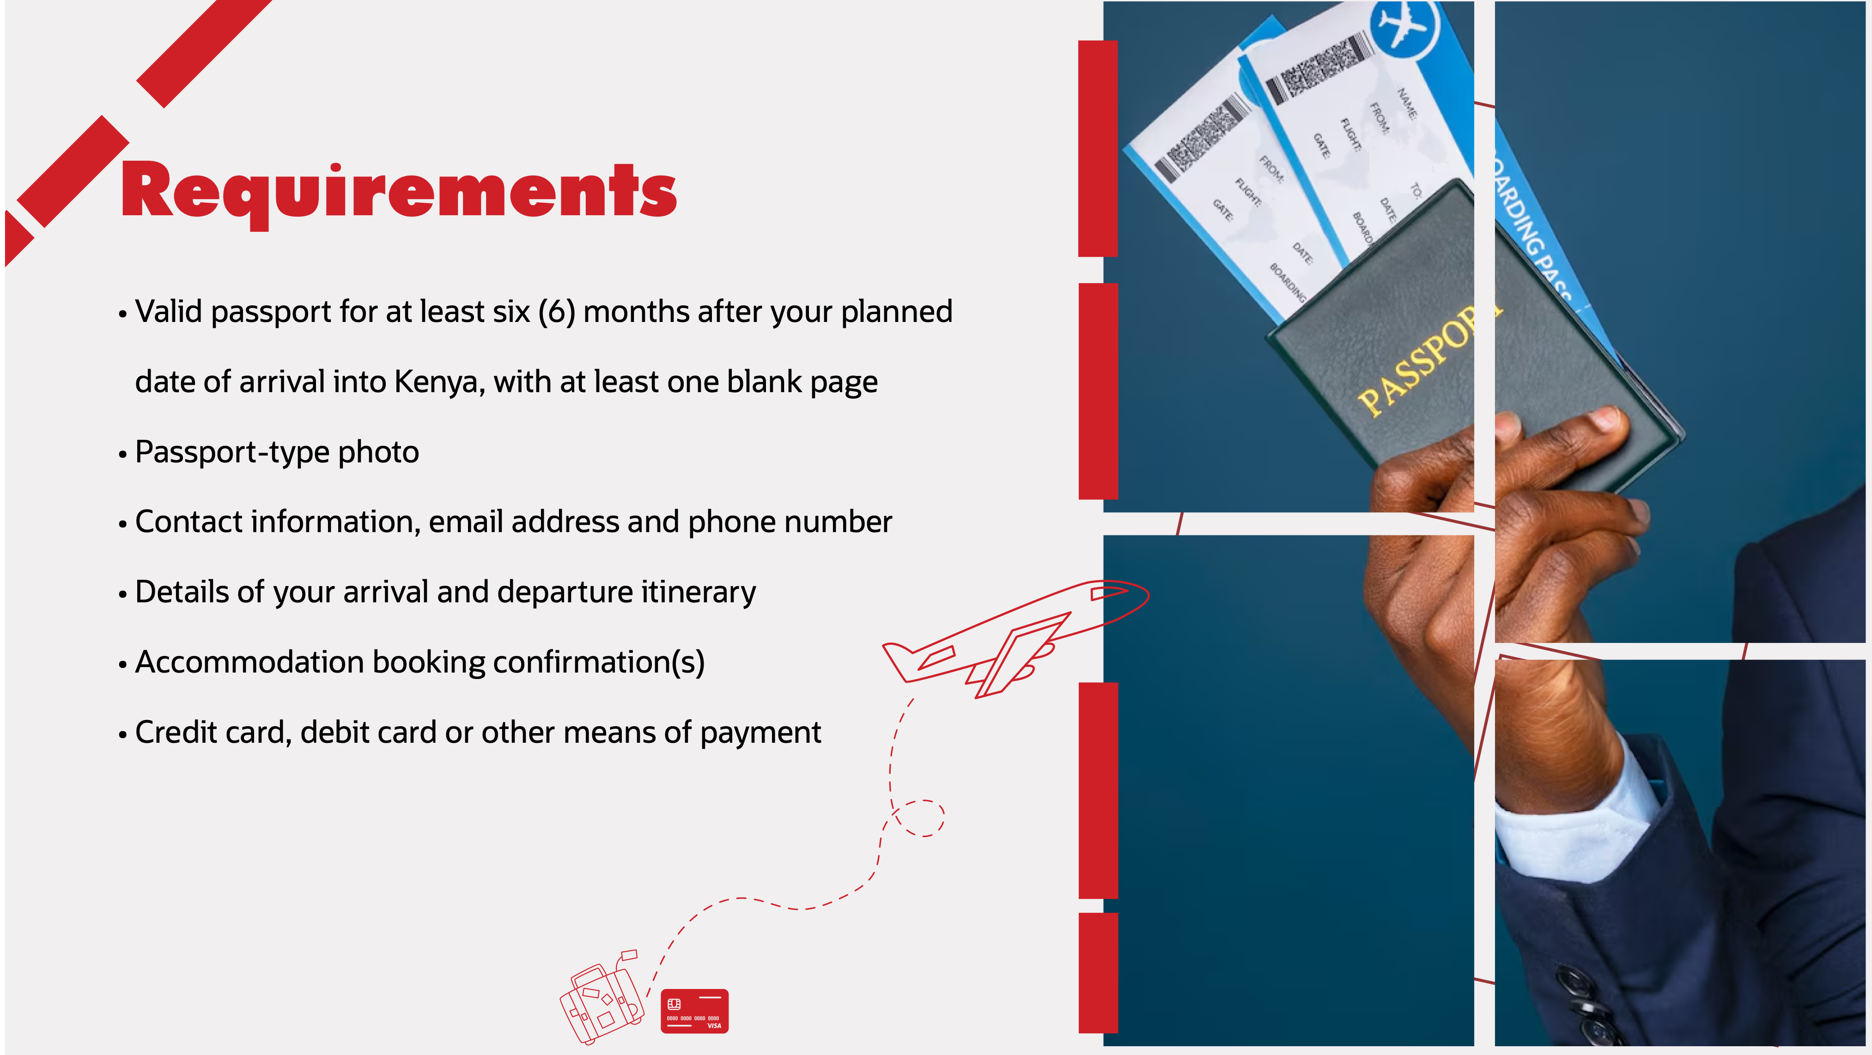
Citizens of the East African Partner States; These countries include Burundi, Democratic Republic of Congo, Rwanda, South Sudan, Tanzania and Uganda. (Exempted for Six (6) months)

